Slide 1
Thesis Proposal Defense
Devon A. Fazekas
April 12, 2021

Slide 2
Overview
Motivation and Rational
Introduction
Background
Research Question
Methodology
Next Steps
Notes:
To keep the introductions brief, I just want to say hello to everyone, and good morning.
Let's jump into the my motivations and the relational that drove this research.

Slide 3
Motivation and Rationale
High risk of ER-involved accidents
Delayed arrival times
Lack of collaboration
Notes:
We've all been there, driving in a city when the whisper of a siren grows from under the songs of the radio. At this moment, you might think to yourself "Where's the firetruck? Should I pull over now?" Maybe you're even stopped at an intersection, blocked in by other drivers. Trying not to hit each other as you all creep a few inches a minute. But before you know it, the firetruck is upon your group, horn blaring. You know you're in its way but what can you do?
Emergencies like this are happening every day. And any delay to the emergency responder arriving at their destination could be the difference between life and death for many. This is why it's vital that emergency responders arrive as fast as safely possible.

Slide 4
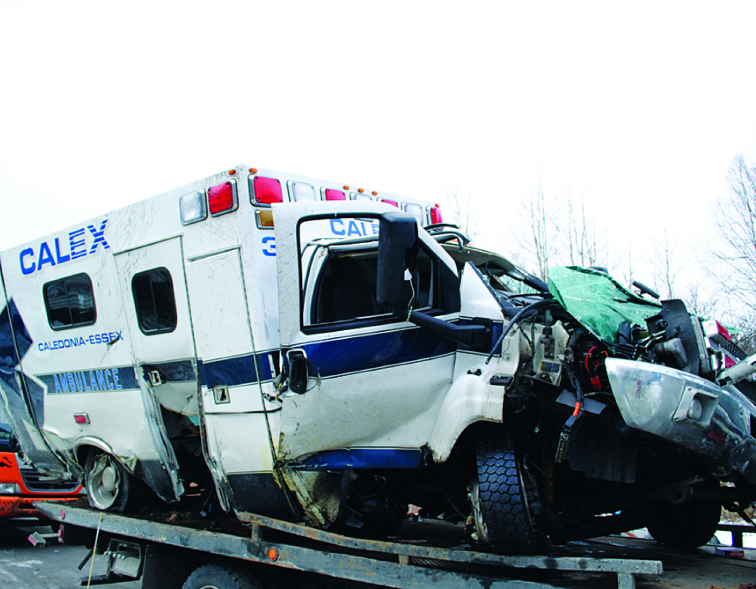
Motivation and Rationale:
High Risk of Accidents
Notes:
Unfortunately, there are so many vehicles on the road today and the numbers are increasing. In cities where most streets are 2-4 lanes wide, this congestion is severely hindering the response times for ERs.
In addition, despite all the safety features in vehicles today, the drivers still struggle to collaborate. On their own, they're forced to split their attention and go through the entire process of analyzing their surroundings, predicting neighboring vehicle movements, and planning how best to avoid or yield to an ER.

Slide 5
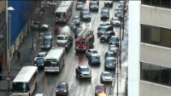
Motivation and Rationale:
Delayed Arrival Times
Notes:
This mental activity requires significant concentration and focus, and is stressful even during optimal weather conditions.
As research shows, drivers often get overwhelmed in this situation and their reactions escalate to further accidents. Statistics show that hundreds of ERs lose their lives when responding to a call, and thousands more are injured.

Slide 6
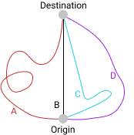
Motivation and Rationale:
Lack of Collaboration
Everyone prefers route B
Everyone choosing route B causes congestion and delays
Nash Equilibrium suggests choosing less optimal routes for individuals to benefit the overall group
Notes:
What I realized was, these situations occur because of the desire to optimize our own routes. It's a Game Theory type of problem.
Take this diagram for instance. Give a hundred drivers the option to choose their own path, and you'll quickly see a traffic jam on route B.
Based on the Nash Equilibrium, it becomes clear that by strategically dispersing the traffic flow among all of the paths, the average travel time and congestion are greatly reduced.

Slide 7
Motivation and Rationale:
Lack of Collaboration
Everyone prefers route B
Everyone choosing route B causes congestion and delays
Nash Equilibrium suggests choosing less optimal routes for individuals to benefit the overall group
Notes:
We all know how we're supposed to make-way for ERs but by the time our biological senses inform us of a nearby ER, we often don't have enough to think and react efficiently.
But If a driver knew a few minutes in advance of an approaching ER, and was told how to detour around it, they could avoid the situation entirely.
This clairvoyance and guidance can only be achieved through a technological solution.

Slide 8
Introduction
By leveraging IoT technology and Cloud Computing, we aim to help civilian drivers avoid route collisions with active emergency responders.
Notes:
The aim of this study is ultimately to leverage technology, specifically cloud computing and IoT technologies, to help drivers overcome human perception limitations. By predicting route collisions and generating detours, we can help drivers avoid situations previously mentioned altogether.

Slide 9
Background
Vehicular communication
Route guidance
Route optimization
Notes:
All of the literature examined supports that technological aid to connected vehicles can significantly improve road safety, traffic efficiency, and reduce travel times.
The literature demonstrated that vehicular communication, driver guidance, and route optimization had profound positive effects.
Some techniques used DSRC to achieve V2V communication. However, the short-range of this communication requires high penetration rates of connected vehicles to generate VANETs and establish robust channels.
Other studies combat this by introducing RSUs into the city's infrastructure, achieving V2I communication. While this empowers a greater range of communication it still isn't in real-time as vehicles outside of the coverage area can't communicate. Additionally, the deployment and maintenance fees for RSUs can be expensive.
As for driver guidance, some studies focused on generating the optimal routes for ERs using the A* algorithm to avoid congested roads. Others suggested techniques for lane changing and lane merging. In all studies, the decision-making computation was offloaded to a computer, resulting in smoother, safer, and more enjoyable experiences for the drivers.
However, none of the reviewed literature tried optimizing the routes of civilian drivers to avoid ERs. Additionally, many of their approaches suffered from scalability and adoption issues.

Slide 10
Thesis Statement
Does preemptively warning and guiding civilian drivers out of the path of active emergency vehicles reduce human error and help maintain a distance between them greater than the safety threshold in Ontario?

Slide 11
Thesis Statement
Population:
Ontario civilian drivers
Ontario emergency responders
Factors:
Distance between civilian drivers and emergency responders
Human error
Topic:
Preemptively warning and guiding connected vehicles
Notes:
Human error entails how the behavior in the presence of an active ER. For example, do they slow-down or speed-up arbitrarily, did they pull over quick enough, were their detours helpful in avoiding the ER?

Slide 12
Methodology
Software system design
Participants
Algorithms
Data collection
Scenarios
Analysis
Notes:
Before any experiments can be performed, we'll need a cloud server and a mobile application.
Given that the experiments is driving centric, we require our participants to have valid driver license and an insured vehicle.
Now let’s jump into the software designs.

Slide 13
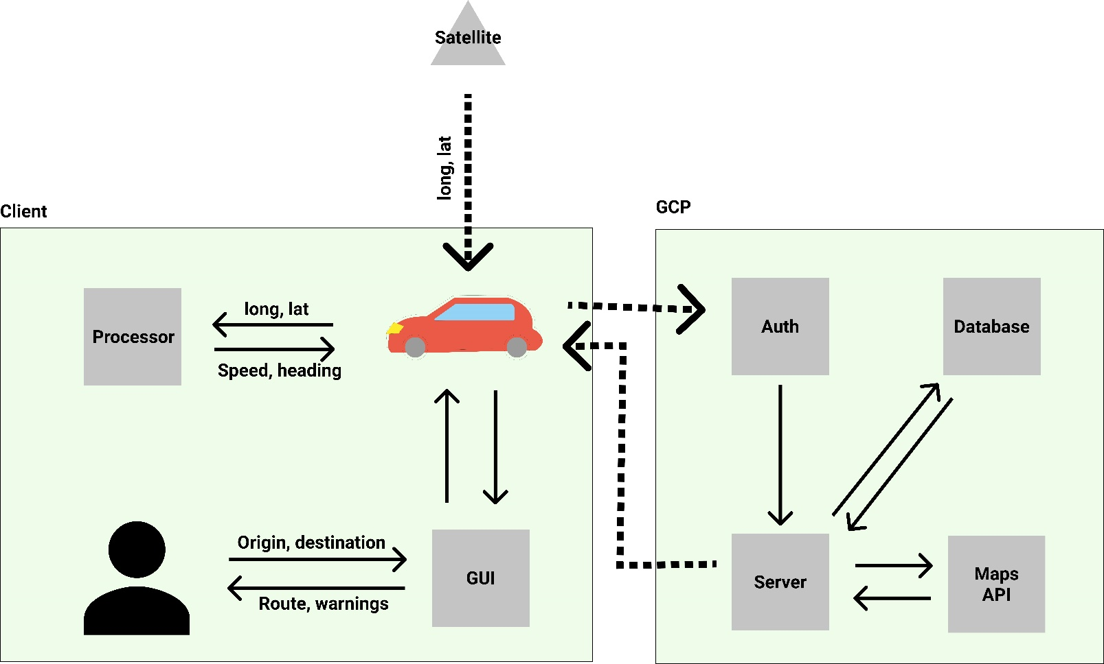
Methodology – Software System Design
Notes:
The system comprises three major entities: client component, cloud component, and GPS satellites.
The participants interact with our system through the GUI node in the Client component; either a mounted smartphone or an embedded application in the vehicle.
The interface is primary a navigational view, displaying directions and emitting a siren-like noise when approaching an active ER.
The processor node communicates with GPS satellites, tracking its location and using it to calculate over vehicular info like speed and heading.
Every second, the application saves a timestamped snapshot of the vehicle's current speed, heading, and location.

Slide 14
Methodology – Software System Design
Notes:
And after every 60-seconds, the Client component sends a batch of snapshots to the Cloud component along with an identifier and type ID for authentication purposes and to help identify whether they're a civilian or ER, where a backup is saved in the database node.
The server node processes and analyzes the traffic data obtained from all the clients. It's performs the collisions predictions and generates personalized routes for the clients.
It monitors the data between a civilian client and all nearby active ERs, recording the relationship data in the database node for later analysis.
When the server node decides a reroute is necessary, it requests a new route from the Maps API node given new restrictions, then relays the detour to the corresponding clients.

Slide 15
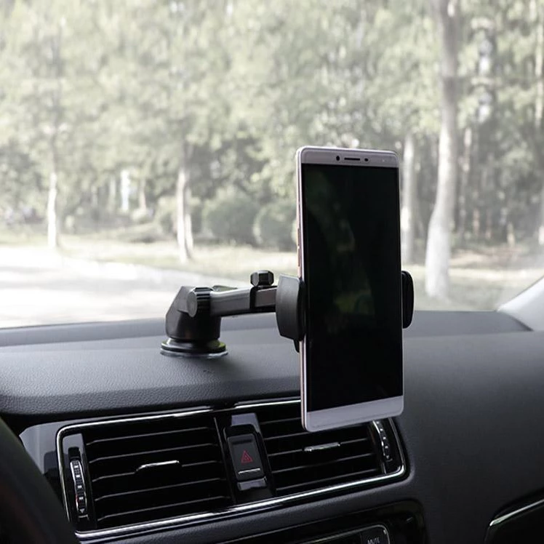
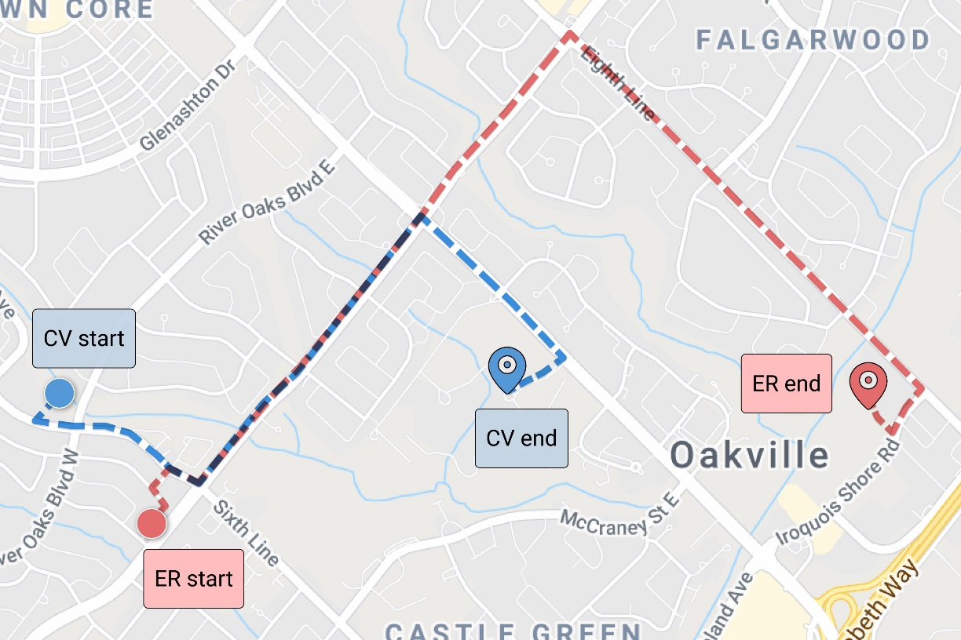
Methodology – Participants
Notes:
Each experiment is configured with pre-set coordinates.
The coordinates were specifically selected to ensure the Google Maps API would return partially overlapping routes for the vehicles.
It also is designed to mimic realistic situations where the ER originates near a real fire station and is destined for a plaza across town, whereas the CV is commuting to a real school (Sheridan) from a nearby plaza.
To avoid device and version compatibility issues we provide participants a mounted testing phone pre-installed with our application. They’re expected to use it as a navigational tool as they commute from their starting position to their ending position.

Slide 16
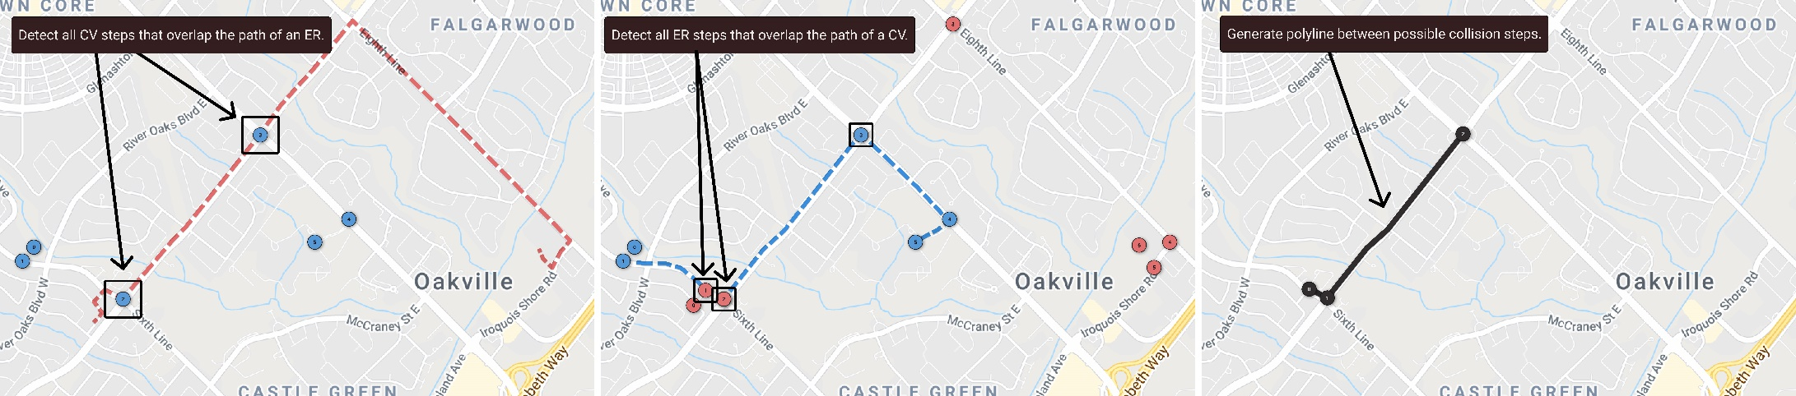
Methodology – Route Collision Detection Algorithm
Notes:
One of the algorithms that the Server node performs is the Route Collision Detection algorithm. It's used to predict when and where route collisions would occur.
Every route for a connected vehicle consists of a series of steps (the circles in the diagram) and a polyline (dotted lines). By cross-references the steps of a civilian driver with the polyline of the ER, and vice versa, we can compute which steps overlap both routes (black circles), and then generate a new polyline between them depicted the overlapping region between both routes.

Slide 17
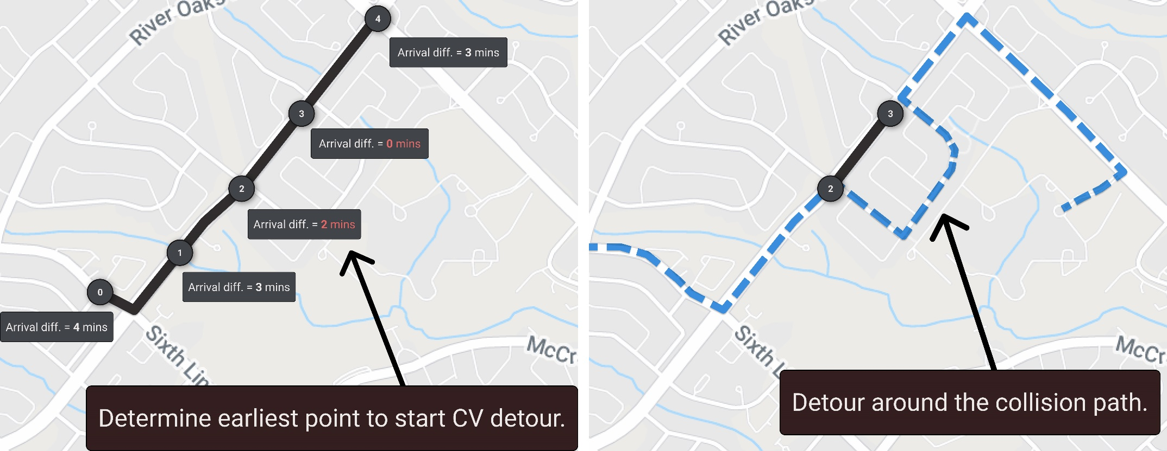
Methodology – Collision Avoidance Algorithm
Notes:
When a collision is predicted, the server node triggers the second algorithm, the Collision Avoidance algorithm.
It starts by breaking down the new polyline into milestones (the circles) and systematically predicts when each vehicle will arrive to each step based on their current average speed.
I arbitrarily chose 2-mins as a time threshold for their absolute difference in arrival times as it should be approximately the shortest amount of time to allow drivers to follow the provided detours.
When the arrival times become smaller than the time threshold, it at this milestone that the detour needs to be made.
The detour is generated to the next milestone, taking the vehicle onto side streets until the safety threshold is preserved.

Slide 18
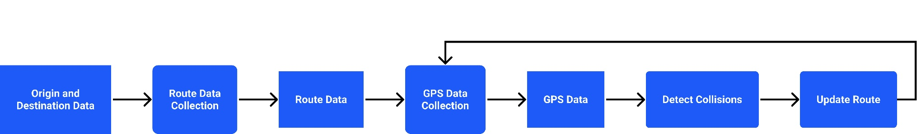
Methodology – Data Collection
Notes:
The flow of data throughout the entire system is depicted in this diagram.
Starting with the client's origin and destination, we provide them an initial route. Then after tracking the movements of clients we can predict collisions and update the route if needed. This process is repeated throughout the entire journey of a client.

Slide 19
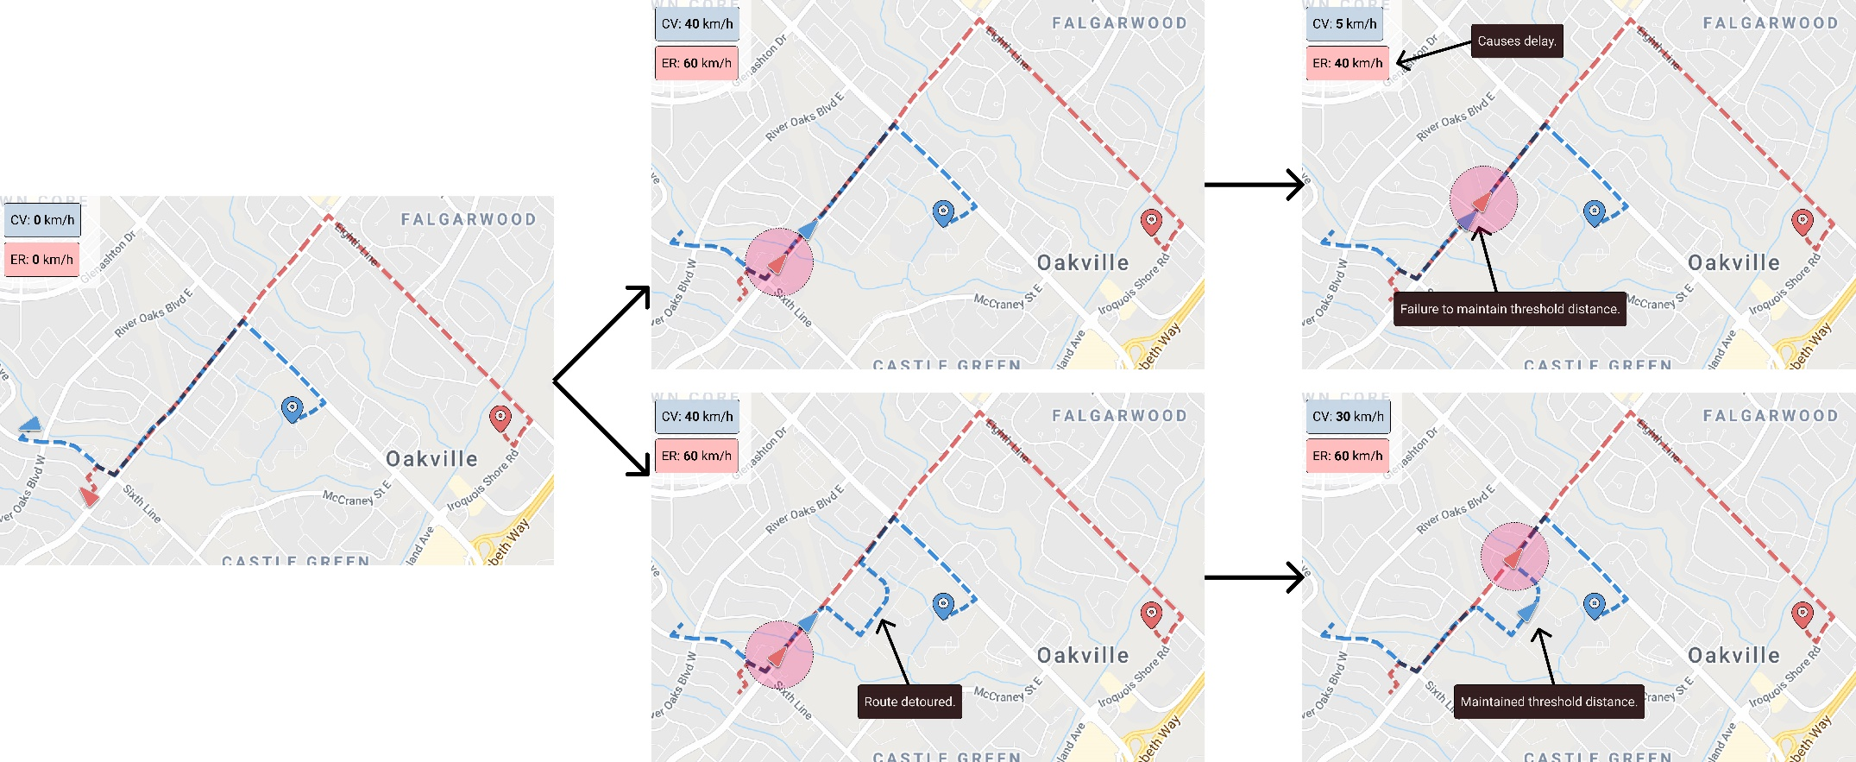
Methodology – Scenario 1
Notes:
I've designed three experiment scenarios that focus on different aspects of emergency situations. Scenario 1, depicted here, examines how a civilian driver reacts to an approaching active ER from behind.
The top row illustrates how I imagine an unaided driver would react; they try to pull over and yield as soon as they recognize the ER, and stop until they feel that they're no longer in the way. In this case, the ER has to slow down to avoid hitting the civilian.
Whereas the bottom row illustrates how the civilian would remove themselves from the path of the ER, allowing both vehicles to travel at regular speeds uninterrupted.
The preceding scenarios examine driver behavior when driving behind an ER, and also approaching an idle ER.

Slide 20
Methodology – Limitations & Restrictions
Code Three Running
Speed limits
Sirens and horns
Affecting public traffic
Penetration rates of connected vehicles
Notes:
In the real world "Code Three Running" permits exceeding speed limits and ignoring red lights and stop signs. We're unable to legally perform these actions in our experiments.
To mimic the speeding of ERs and allow them to overtake the civilian drivers, we chose to constrain our participants' maximum speeds to 70% of the speed limit of any given road.
As for the usage of sirens to gain the attention of civilian drivers, we've chosen to have the application emit a quiet siren-light noise whose volume increases proportionally with the decreasing distance between the vehicles.
The noise is intended to inform the civilian driver of a nearby active ER without providing context to its exact location or heading.

Slide 21
Next Steps
Host the server in GCP
Write the route collision detection algorithm
Write the collision avoidance algorithm
Develop mobile application
Preliminary field testing
Participant recruitment
Experimentation & data collection
Analysis
Final report

Slide 22
References
[1] Hongwei Hsiao, Joonho Chang, and Peter Simeonov. Preventing emergency
vehicle crashes: Status and challenges of human factors issues. Human factors,
60(7):1048{1072, 2018.
[14] Leading causes of death in 2021, 2021.
[25] F. Lyu, H. Zhu, N. Cheng, H. Zhou, W. Xu, M. Li, and X. Shen. Characterizing
urban vehicle-to-vehicle communications for reliable safety applications. IEEE
Transactions on Intelligent Transportation Systems, 21(6):2586{2602, 2020.

